Slide 1

Presented By: Pratul Pandey Intern ID :- IN9240508

Slide 2
Assignment
EDA Project - Analysis of AMCAT Data
Analysis on AMCAT Data

Slide 3
• Title : EDA Project – Analysis on AMCAT Data • Subtitle : Based on the information provided, this dataset seems to contain information about individuals, likely job seekers or employees, with various attributes like experience, education, skills, and salary

Slide 4
Objective: The objective of this EDA is to explore the data, understand its characteristics, and identify potential relationships between variables, particularly focusing on "Salary" as the target variable.

Slide 5
• Data collection and preparation: Gathering and processing large datasets of patient information. • Model development and training: Experiment with different machine learning algorithms to build the most accurate prediction model. • Evaluation and validation: Rigorously testing the model's performance and refining it for optimal accuracy.

Slide 6
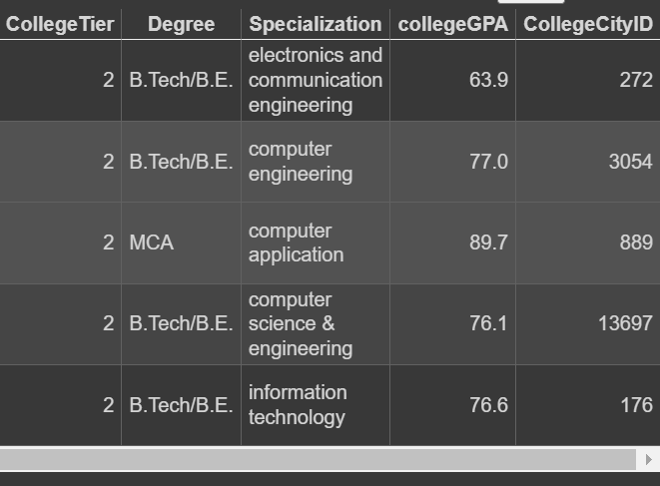
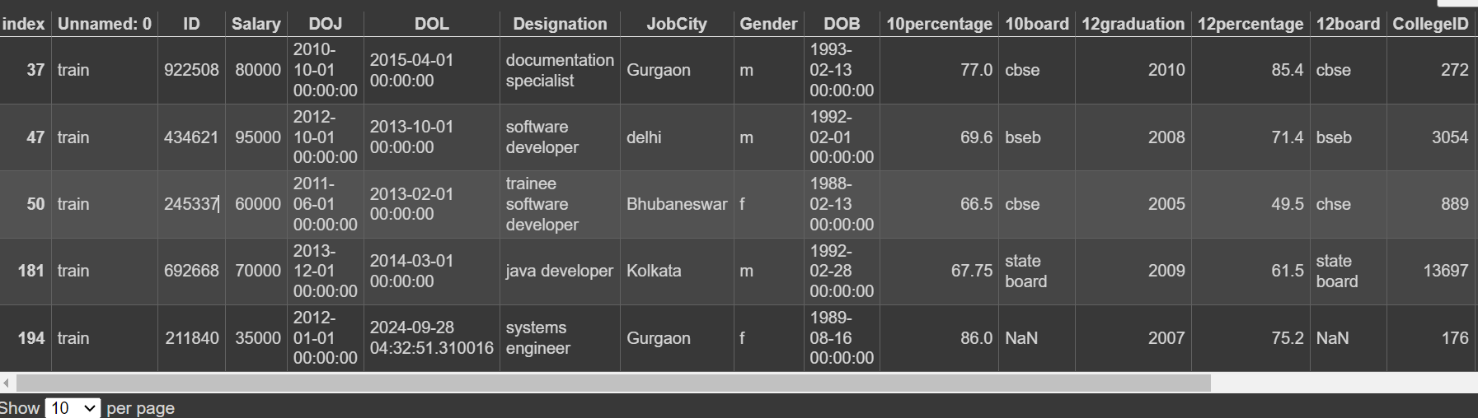
Head of Data:

Slide 7
Pre-Porcessing:
Date/Time Columns (DOJ, DOL, DOB): Need format verification and conversion.
Job City: Replace "-1" with NaN and consider imputation based on other info.
Board Scores (10th & 12th): Replace "0" with NaN and consider imputation or separate categories.
College State: Replace "union territory" with a specific state or category.
Graduation Year: Replace "0" with NaN and consider imputation based on other attributes.
Domain: Replace "-1" with NaN and consider imputation based on other info or create a separate category

Slide 8
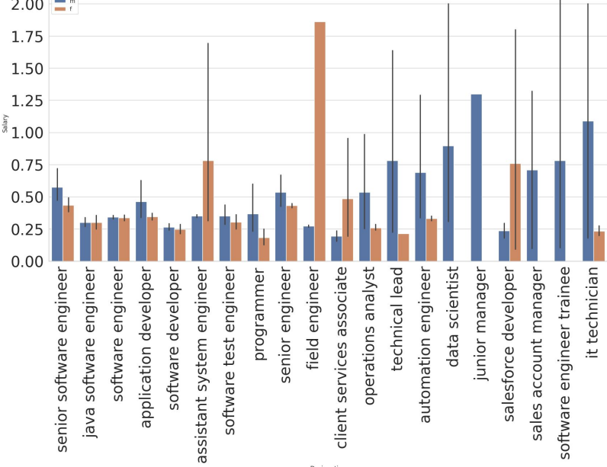
Analysis on Salaries
Dominated by IT: Most high-paying positions are within the IT sector.
Gender Gap: Men earn more in 45% of top roles, while women earn more in 20%.
Missing Women: Some high-paying fields (e.g., junior manager, sales account manager) lack female representation.
Highest Paid (Men): Junior manager.
Highest Paid (Women): Field engineer.
Most Frequent & Highest Paid: Software engineer and software developer (both genders)

Slide 9
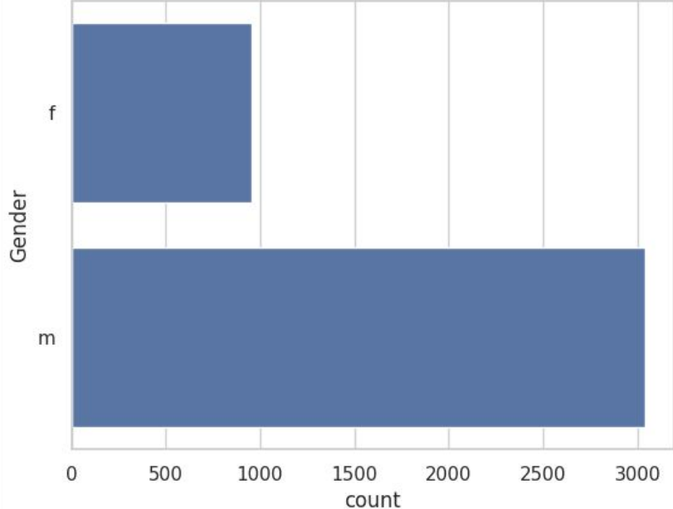
Ratio of Male and Female in Company
The ratio of men is 3 times greater than female.

Slide 10
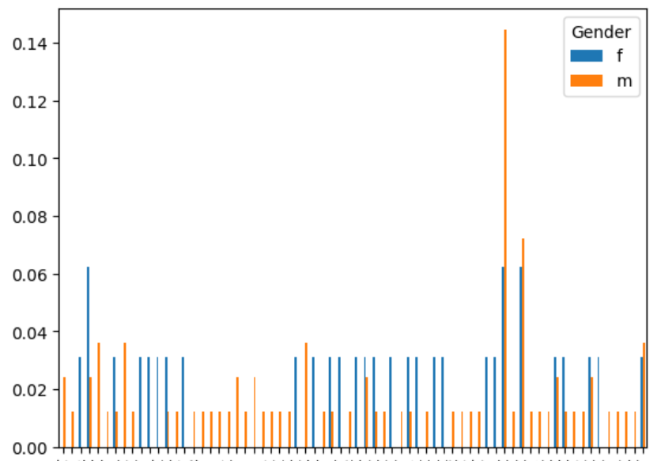
Common roles are taken by the amcat aspirants
Analysis of common IT roles reveals a significant gender imbalance, with males dominating most professions. IT fields showcase a concerning gender gap, with men heavily outnumbering women in most common roles. The plot hints that specialization preferences might play a role in this disparity While analyzing frequent IT roles, a striking trend emerges: males significantly outnumber females across these professions. Examining specializations, the plot suggests a possible association between specific fields and gender distribution.

Slide 11
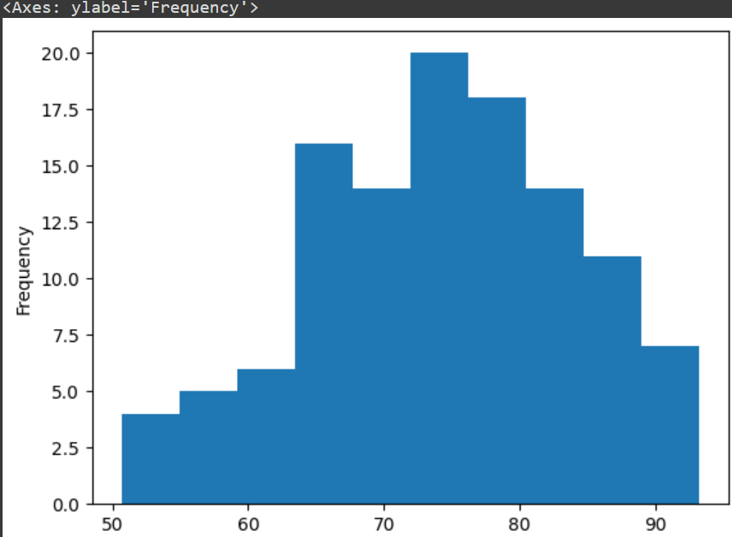
10percentage
The graphs show peak at 70 to 80

Slide 12
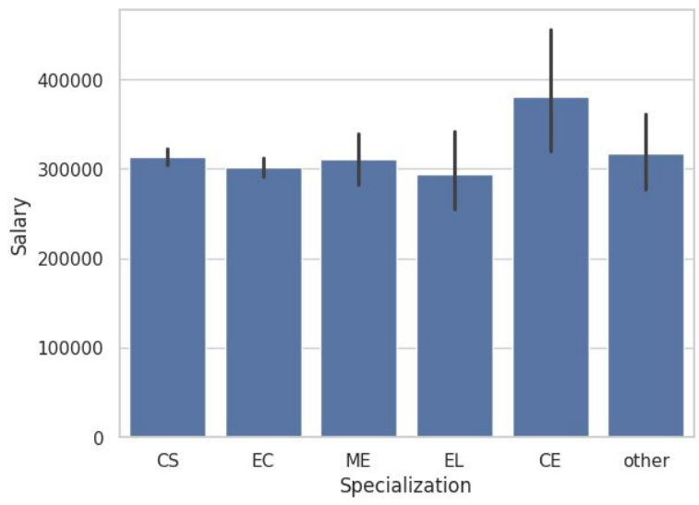
Branch wise Salaries
CE graduates stand out, earning substantially more on average than their peers from other branches. Choose wisely! Our data reveals that Computer Engineering graduates earn considerably more on average compared to other branches, where salaries show minimal variation. This insight could be valuable for aspiring students considering their academic paths

Slide 13
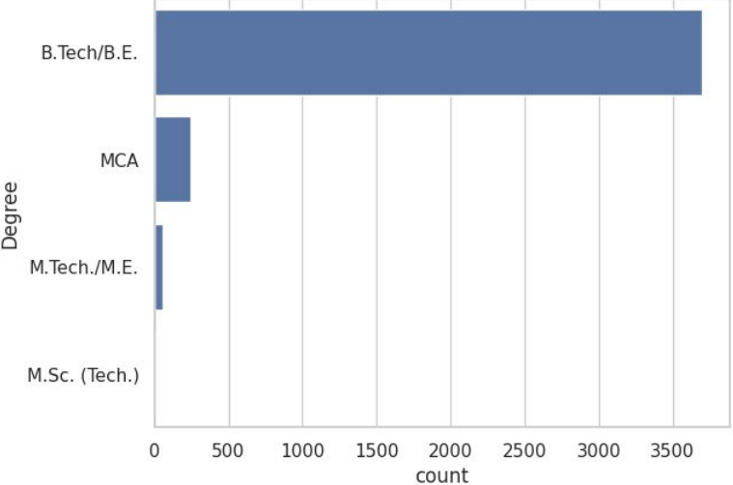
Degree of AMCAT
Most of the AMCAT aspirants are from B.tech domain

Slide 14
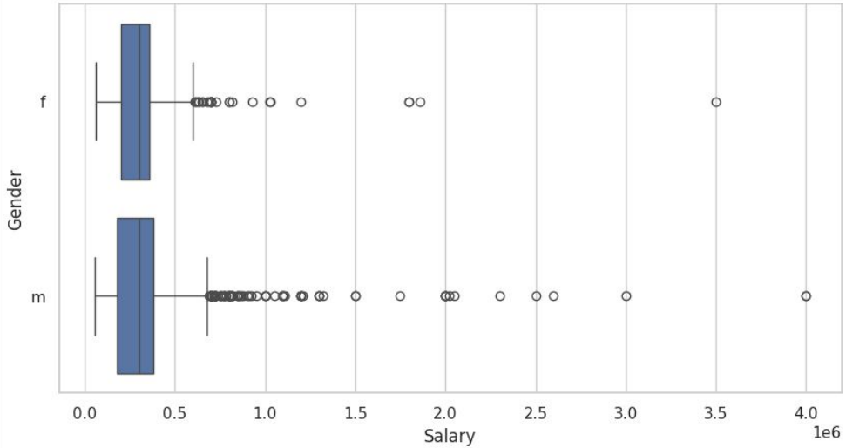
Analysis on Salary
It is noted that there are many outliers in the salary data There is not much difference between median salary for both genders. We can also observe male have more outliers indicating they are more people getting higher pays in male than female categor

Slide 15
Overall Conclusions
Demographics: Predominantly male: Majority are male applicants. IT-focused: Most aspirants choose the IT domain. Experience: Average experience around 5 years. Education: B.Tech degree, often from tier-2 colleges in Uttar Pradesh. Specialization: Computer Science/Information Technology common choices.
(2) Salary and Careers: Average salary: Around ₹300,000 annually. High-paying roles: IT fields dominate, with Software Engineer and Software Developer being the most popular and well-paying choices.

Slide 16
Thank You

